Slide 1
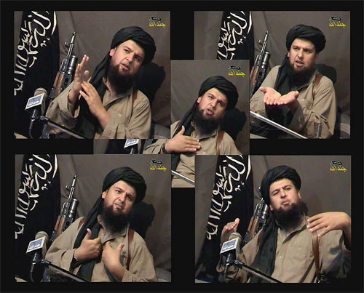
Developing Alternative Narratives in CVE.

Slide 2
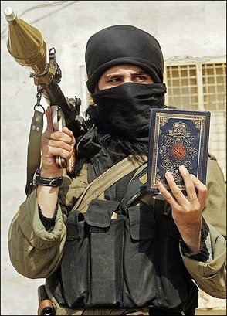
Look at four questions:
What do we mean by Narrative?
What’s the information environment that propagates them?
What makes them effective?
What’s the media’s role in all of this?

Slide 3
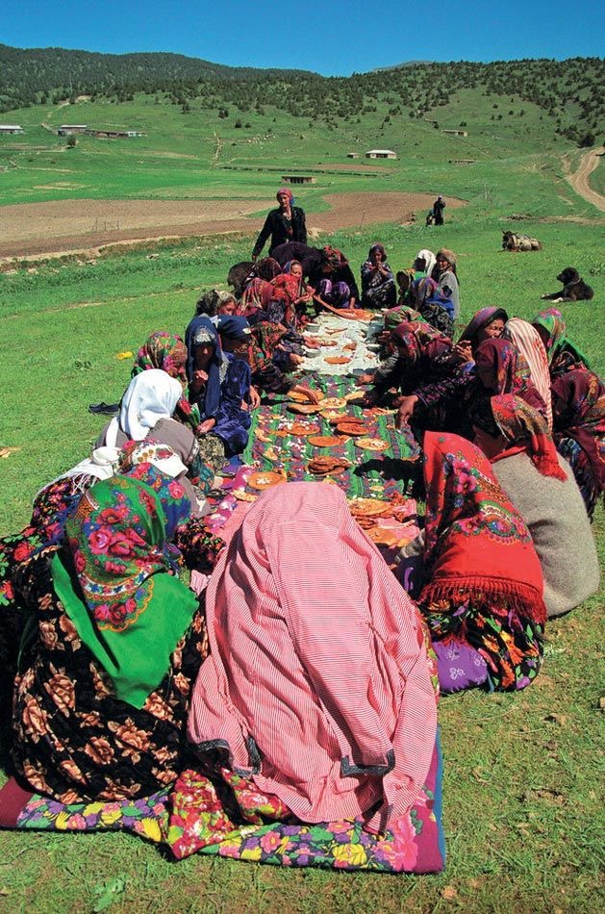
Narratives?
People get, understand and share information from the stories they hear.
Stories come from multiple sources and experiences and feed conversations and discussion.
A string of mutually reinforcing stories produce a shared narrative that affects opinion and behaviour.
Narratives are the way people understand complex issues.

Slide 4
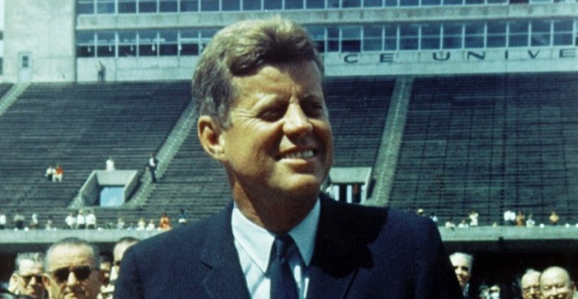
“The great enemy of the truth is very often not the lie – …….. - but the myth. Too often we hold to the clichés of our forebears. We subject all facts to a predetermined set of impressions. We enjoy the comfort of opinion without the discomfort of thought.”
Yale speech, 1962

Slide 5
The information/media environment?
The ubiquity of the mobile phone.
The tyranny of real time.

Slide 6
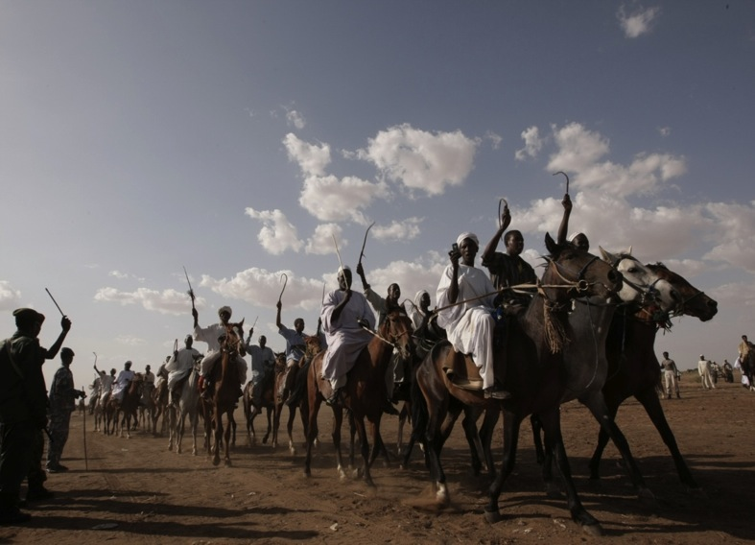

Slide 7
The information/media environment?
The ubiquity of the mobile phone.
The tyranny of real time.
Everybody’s a storyteller.
The “post truth society” where opinion and belief matters more than facts and accuracy.

Slide 8
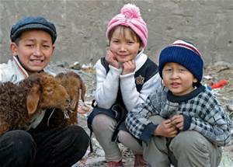
What makes narratives effective?
It’s about being local and being seen to be listening as well as speaking!

Slide 9
Extremists start at the grass roots and exploit local grievances.
Governments start from the top down and are often mistrusted and perceived as remote from the local issues.
Authentic local voices more effective than government ones.

Slide 10
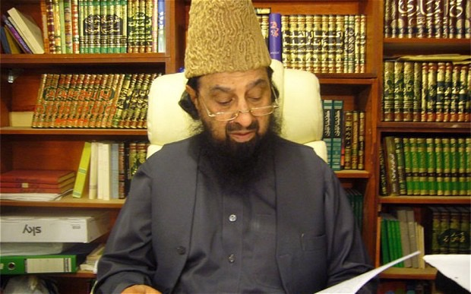
Are counter narratives or alternative narratives the best approach?

Slide 11
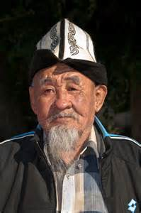
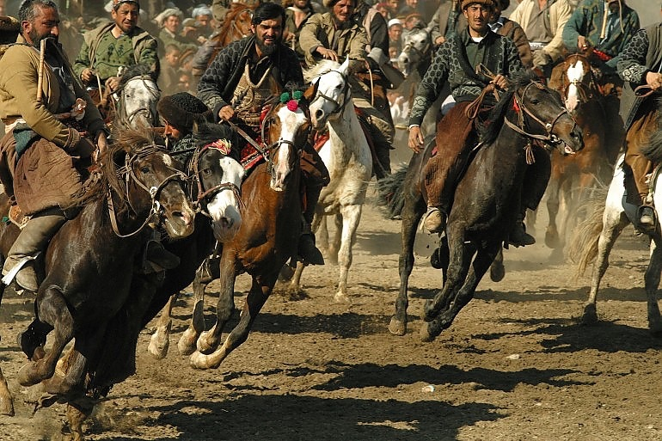
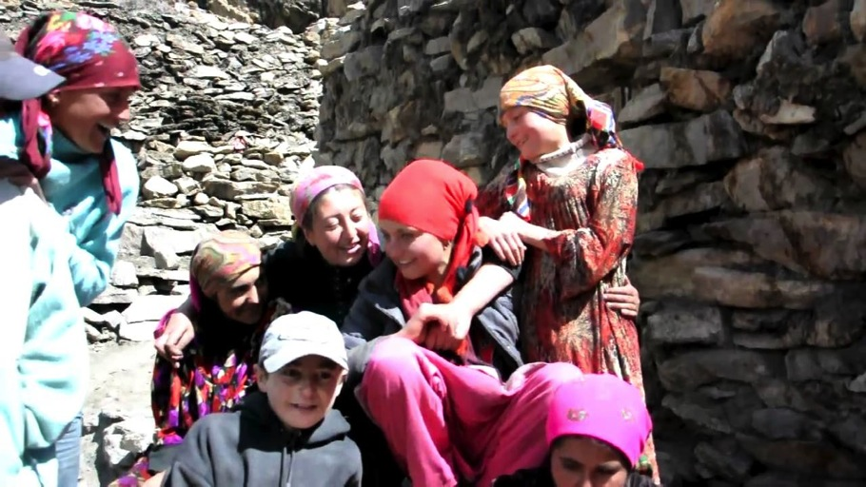
Tell your own positive stories.
Reinforce community resilience.
Use culture as a bulwark to identity.
Understand local issues.
Be credible.

Slide 12
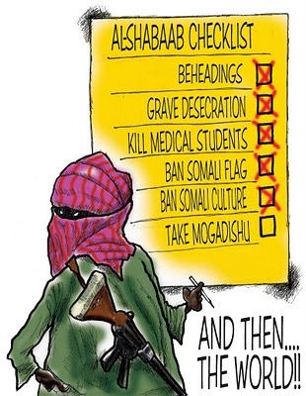
Foreign led.
Foreign practices.
Counter cultural
Not Somali

Slide 13
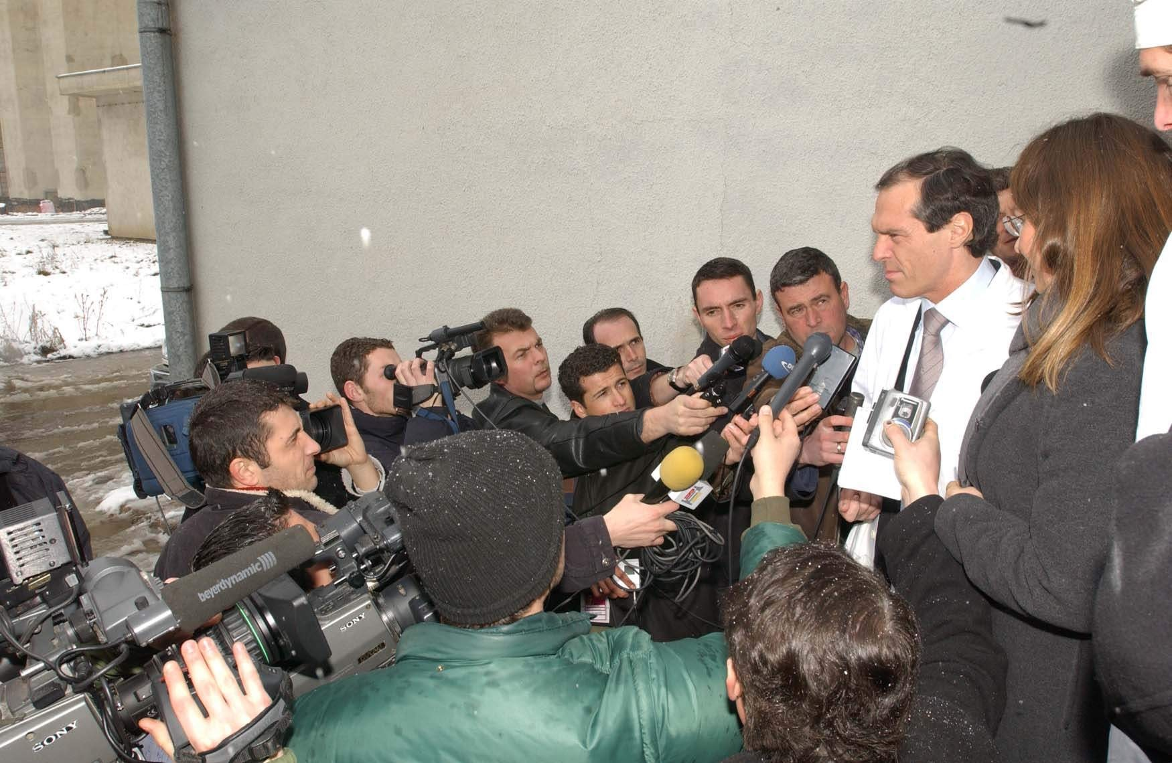
What’s the media’s role?
The media as a battle ground.
The responsibility of mainstream media and how news is covered.
Media literacy?

Slide 14
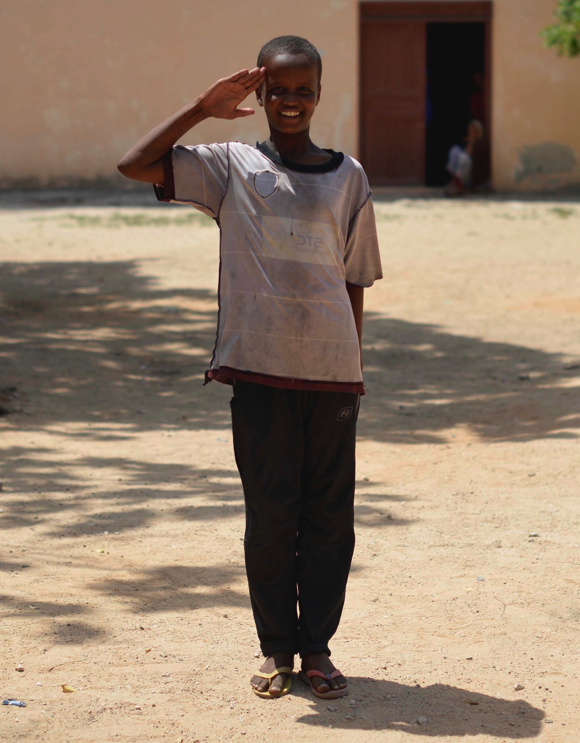
Thank You!

